Slide 1
Predicting Median Housing Prices
Biniam Abebe, Binod Nepal, Sharon Schoolcraft, & Maybel Hernandez ADTA 5340-412: Discovery and Learning with Big Data/Data Discovery
University of North Texas

Slide 2
Introduction
Having an accurate prediction of housing prices would be beneficial for multiple stakeholders which include home buyers, house sellers, investors, and urban planners, when making important decisions for the future. This project revolves around exploring market data of the real estate industry by researching and forecasting property values and their impact on home prices.
Our project is centered around studying median housing prices using data from realestate.com's Real Estate Data and Market Trends. The goal is to explore the numerous factors that can impact housing prices and better decipher the housing market. Using our research and analysis, we aim to provide valuable insights that can empower individuals and communities allowing them to successfully navigate the real estate market with confidence helping them make well-informed decisions.

Slide 3

Data Understanding & Data Preparation:
The original dataset is a historical view of the monthly median listing prices by counties. The dataset is 288386 rows by 40 columns. The last month of entry for the dataset is March 2024 and the oldest entry is for July 2017.
The dataset provides valuable information to help predict prices like time on the market and reductions in cost. The dataset also flags outliers in the final column.
After cleaning and enriching the data set, we had 14 variables remaining. Of these 16 variables we have 6 qualitative variables and 10 quantitative variables.

Slide 4
Exploratory Data Analysis (EDA): by Sharon

Slide 5
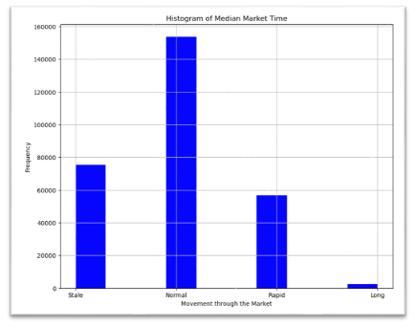
Median Market Time
We transformed the variable Median_Days_on_Market by reducing the variable into a categorical feature (Median_Market_Time) by rebinning the information into four labels: Rapid (less than 45 days), Normal (46 to 90 days), Long (91 to 145 days), and Stale (longer than 146 days.)

Slide 6
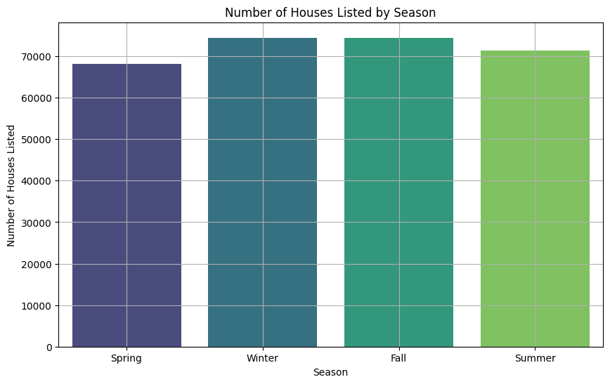
Season
The variable month_date_yyyymm was split and sectioned off into months and years. Then the months were reduced by binning into seasons.

Slide 7
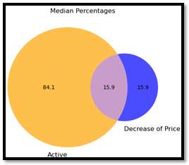
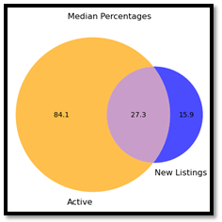
EDA continued:
New Listing Proportions, Price Reduced Proportions, Price Increase Proportions, Active Listing Proportions, Pending Listing Proportions.

Slide 8
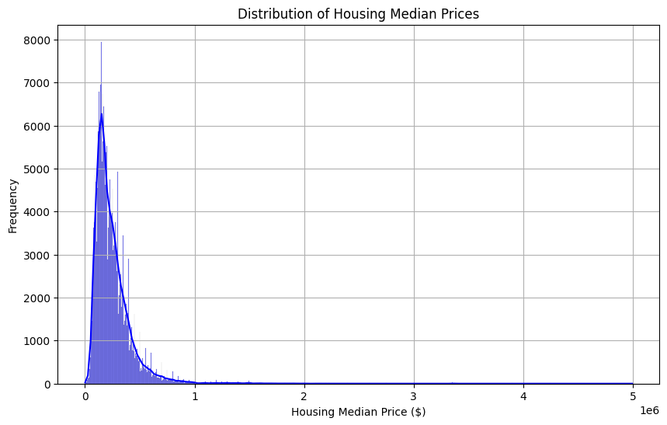
Distribution of Housing Median Prices:
The right-skewed distribution suggests a few houses have significantly higher prices
Indicates potential market outliers or premium real estate segments
Understanding factors driving high-priced properties is crucial
Essential for identifying market trends, assessing risk, and developing strategies

Slide 9
Methodology By Binod

Slide 10
Methodology
Dummy variables - Categorical Help us to easily compare different categorical values since the columns were directly comparable to one another.
Scale – Numerical - The purpose of this step was to transform the data into a format that would allow our upcoming machine-learning models to better process the data, thereby improving the performance of our subsequent models.
Features selection - feature selection was critical as focusing on the most relevant features allowed us to reduce our data's dimensionality
Model Development – Model development involve creating and refining machine learning algorithms to make accurate predictions or classifications based on input data.
Linear Regression – Linear Regression specifically designed for modeling and relation between one or more independent variables (features) and a continues dependent variable.
Model Development
Dummy variables
Scale the data
Features selection
LinearRegression()

Slide 11
Performance Metrics by Biniam

Slide 12
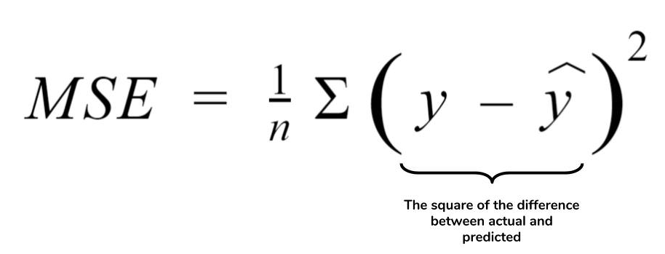

Performance Metrics
Mean Squared Error: MSE measures the average squared difference between actual and predicted values. Which will help to see how well the model fits the data. The lower MSE value means Model predictions are closer to the actual values and higher MSE values mean larger discrepancies, which means poor model performance.
Rood Mean Squared Error: RMSE is the square root of the MSE, providing an interpretable measure in the same units as the dependent variable. Lower RMSE indicates better model performance and higher RMSE indicates predictions have larger discrepancies from the actual values. That means the model has poorer performance in terms of accuracy.​

Slide 13

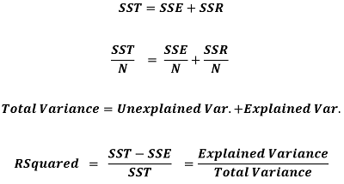
Performance Metrics
Mean Absolute Error: MAE is a metric used in regression analysis to measure the average absolute difference between the actual and predicted values of the target variable. Lower MAE indicates better model performance which reflects smaller discrepancies between prediction and actual values.
The Coefficient of Determination (R-squared): R-Squared represents the proportion of the variance in the dependent variable explained by the independent variables in a regression Model. It ranges from 0 to one, where 0 indicates that model does not explain any variability in the dependent variable and 1 indicates that it explains perfectly all the variability.

Slide 14
Key Findings

Slide 15
Results
Model | MSE | RMSE | MAE | R2
Linear Regression | 0.397758 | 0.630680 | 0.307621 | 0.629589
Polynomial Regression | 0.205956 | 0.453824 | 0.205571 | 0.808204
MSE measures the average squared difference between the estimated and actual values. A lower MSE indicates a model with better accuracy.
RMSE is the square root of MSE and measures the average magnitude of the error. As with MSE, lower values are better.
MAE calculates the average magnitude of errors in a set of forecasts without regard for direction. Polynomial models have lower MAE, indicating that they are more accurate.
The polynomial regression model has much higher R2 values than the linear regression model, indicating that it explains more of the dataset's variability.

Slide 16
Conclusion by Maybel

Slide 17
Conclusion
Predicted median housing prices for stakeholders.
Gained valuable insights through data exploration and analysis.
Polynomial Regression model outperformed Linear Regression.

Slide 18
Recommendations
Data Collection
Expand sources: Amenities, crime rates, economic indicators.
Collaborate with local agencies for comprehensive data.
Data Preparation
Use advanced techniques for complex data structures.
Explore feature engineering for deeper insights.
Modeling & Evaluation
Experiment with ensemble methods & neural networks.
Employ cross-validation for robust model assessment.
Deployment & Monitoring
Develop user-friendly interfaces for market exploration.
Implement monitoring for performance tracking & retraining.
Documentation & Communication
Maintain detailed records of the entire process.
Share findings through reports & visualizations.

Slide 19
Explore regional market variations and additional variable impacts.
Apply advanced modeling techniques for enhanced accuracy.
Share research insights to benefit the field.
Further research

Slide 20


References
Residential data, December 2023, Apr 13, 2024 https://www.realtor.com/research/data/.
Pedregosa, F., Varoquaux, G., Gramfort, A., Michel, V., Thirion, B., Grisel, O., ... & Vanderplas, J. (2011). Scikit-learn: Machine Learning in Python. Journal of Machine Learning Research, 12, 2825-2830.

